Slide 1



Automatic calculation of the local aortic compliance from thoracic cine-MRI
Manos MARKODIMITRAKIS
Supervisor: Alain LALANDE
Notes:
Good morning, I am Manos Markodimitrakis and I will present to you my thesis with title “”.
During my internship I have been working in collaboration with ImVia and UoB.
I would like to thanks my colleagues and my supervisor Alain Lalande for his guidance.

Slide 2
Clinical Background

Slide 3
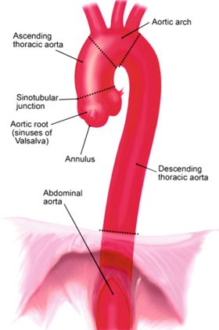
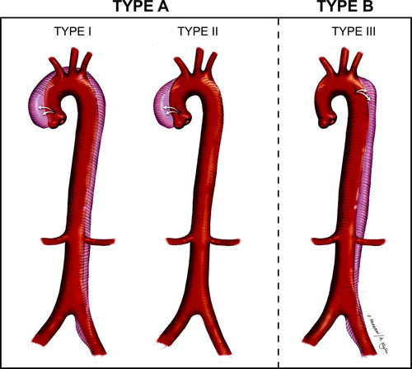
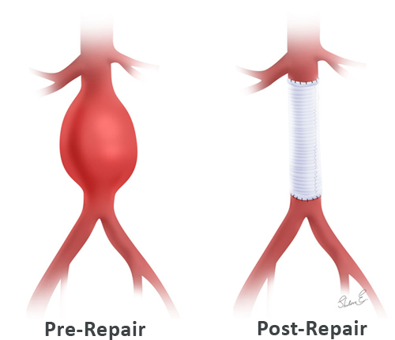
Aorta
Largest artery
Blood flow to body
Ascending Aorta Aneurysm
Reduce elasticity - compliance
Dissection - Rupture
High mortality rate
Urgent surgery is mandatory
Sources:
https://www.sciencedirect.com/science/article/pii/B9780124202191000057
https://www.ahajournals.org/cms/asset/ad15a2fb-f3a6-4810-8c54-247fe1169899/13ff1.jpg
https://www.honorhealth.com/sites/default/files/pictures/medical-services/aneurysm-surgery-honorhealth.png
1
Clinical Background | Problem Definition | Aorta Segmentation | Evaluation | Results | GUI | Conclusions
Notes:
Aortic artery is the largest artery in the human body, responsible for the blood flow from the hurt to the whole body.
One of the most dangerous implications of the aorta is the aortic aneurysm, where the aorta loses its elastic properties.
It becomes more stiff and it is possible that a dissection or rupture may occur.
Aortic dissection has high morality rate and surgery is mandatory.
In this work we focus only at the ascending aorta where type A and type B aneurysms can occur.

Slide 4
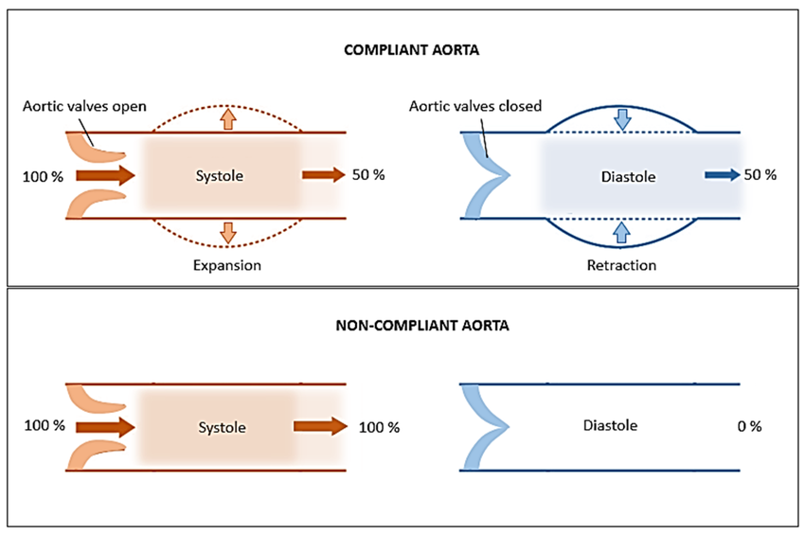
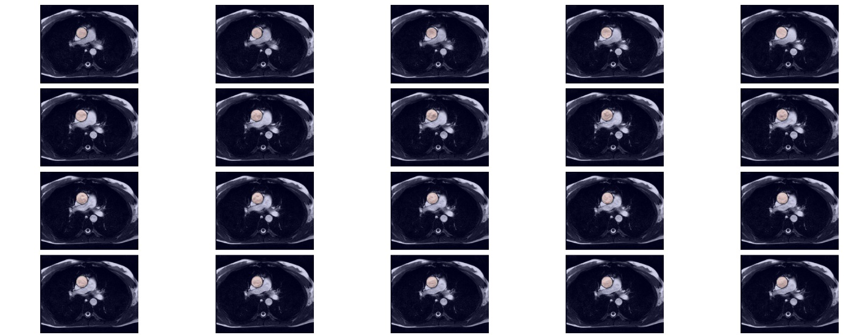

Compliance
Images along cardiac cycle
1
Maximum area
……..…
Minimum area
25
30
Source: https://www.researchgate.net/publication/279731326
$Compliance=\frac{Maximum area −Minimum area }{Systolic pressure −Diastolic pressure}$ $(\frac{mm^{2}}{mmHg})$
2
Clinical Background | Problem Definition | Aorta Segmentation | Evaluation | Results | GUI | Conclusions
Notes:
At the top images we can observe a healthy or compliant aorta, with high elasticity
During systole the aortic wall expands to withstand blood pressure, and retracts (getting back to the initial size) during diastole.
A non-compliant aorta is presented on the bottom images, where during systole and diastole the aortic wall doesn’t expand.
Compliance is define as the relative change in aortic cross-sectional area divided by the change in arterial pressure.
From the previous slide, we need to find which slice has the minimum and which has the maximum area -----------------------→ Maybe add connection here with previous slide
Pressure is provided by physicians measured during MRI acquisition

Slide 5
Problem definition

Slide 6
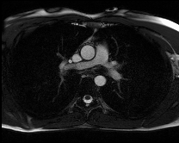
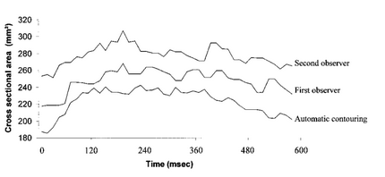
Limitations
41 image slices
Inter-observer variability
Source: Lalande A, Khau van Kien P, Salvé N, et al. Automatic determination of aortic compliance with cine-magnetic resonance imaging: an application of fuzzy logic theory. Invest Radiol. 2002;37(12):685-691.
Compliance is very sensitive to noise and outliers
3
Clinical Background | Problem Definition | Aorta Segmentation | Evaluation | Results | GUI | Conclusions
Notes:
To asses the elastic properties, physicians acquire MR images across the cardiac cycle.
Contouring each slice is necessary, for the process of elasticity evaluation.
Compliance is very sensitive to noise

Slide 7
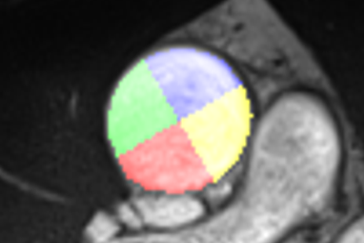
Aorta segmentation
Time consuming task
Intra-observer & inter-observer variabilities
Solution? -> Automatic segmentation potentially with deep learning
Compute global & local Compliance
Split aortic wall in four quadrants (for local compliance)
Compare results with ex-vivo testing [1] from aortic samples retrieved during surgery
Source: [1] Lin S, Morgant M, Marın-Castrillon D, Walker P, Serge Aho Gele L, Boucher A, Presles B, Bouchot O, and Lalande A. Aortic local biomechanical properties in the ascending aortic aneurysms (under review). ACTA Biomaterialia, 2022.
4
Clinical Background | Problem Definition | Aorta Segmentation | Evaluation | Results | GUI | Conclusions
Notes:
The process of manual contouring the aorta is an extremely high consuming task
And it can introduce intra & inter observer variability
To deal with this we propose a fully automated segmentation method using deep neural networks
One of the main objective after the segmentation is the calculation of global and local compliance.
Lin et al. propose the division of the aorta into four quadrants, to assess local biomechanical properties of the ascending aorta.
We aim to compare our in-vivo results with the results of the referenced ex-vivo testing from aortic samples retrieved during surgery.

Slide 8
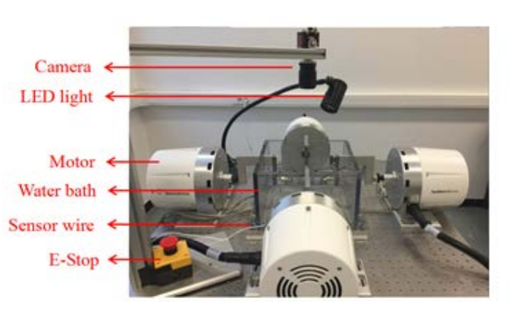
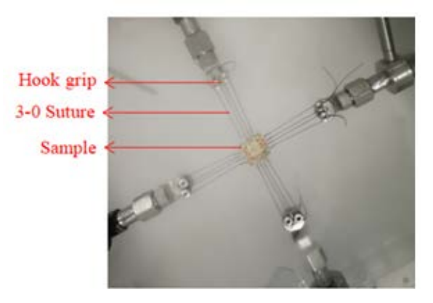
Ex-vivo biaxial testing
Ex-vivo testing [1] from aortic samples:
Collect aortic sample during surgery
Divide into four quadrants
Stretch the samples with bi-axial test until rupture
Measure the stiffness (Maximum Young’s Modulus)
Young’s modulus is a metric for determining how difficult it is to produce elastic deformation in solid materials
Source: [1] Lin S, Morgant M, Marın-Castrillon D, Walker P, Serge Aho Gele L, Boucher A, Presles B, Bouchot O, and Lalande A. Aortic local biomechanical properties in the ascending aortic aneurysms (under review). ACTA Biomaterialia, 2022.
5
Clinical Background | Problem Definition | Aorta Segmentation | Evaluation | Results | GUI | Conclusions
Notes:
As mentioned earlier, in the work of Lin et al. aortic samples are harvested during surgery
Afterwards, they divide the aortic wall into four quadrants
And they perform biaxial stretching test until the sample is ruptured
The purpose of this testing is to measure stiffness properties among the Maximum Young’s Modulus

Slide 9
Automatic aorta segmentation

Slide 10
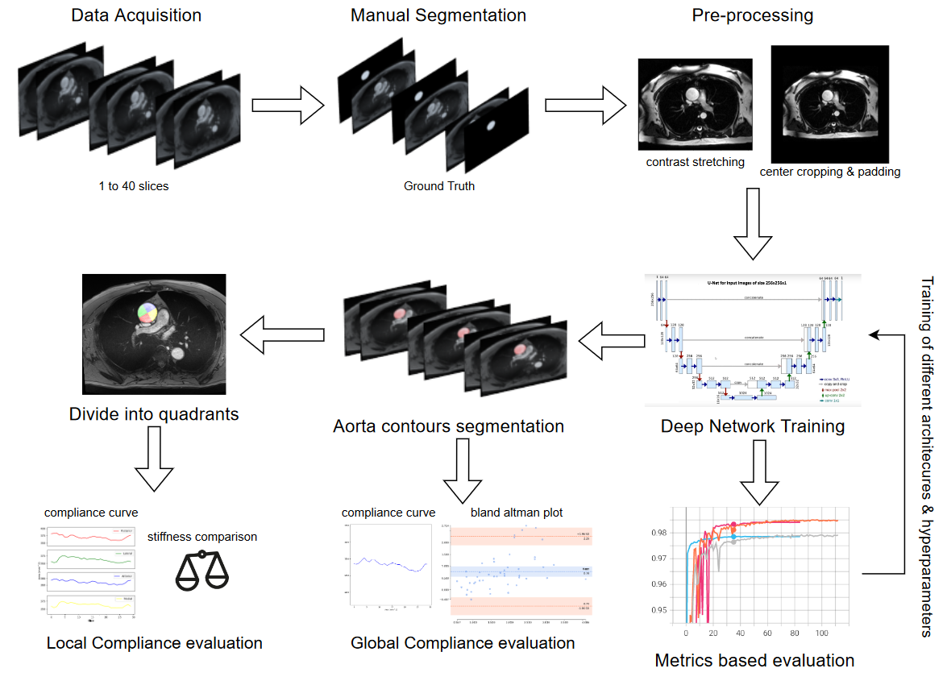
End to end pipeline
6
Clinical Background | Problem Definition | Aorta Segmentation | Evaluation | Results | GUI | Conclusions

Slide 11

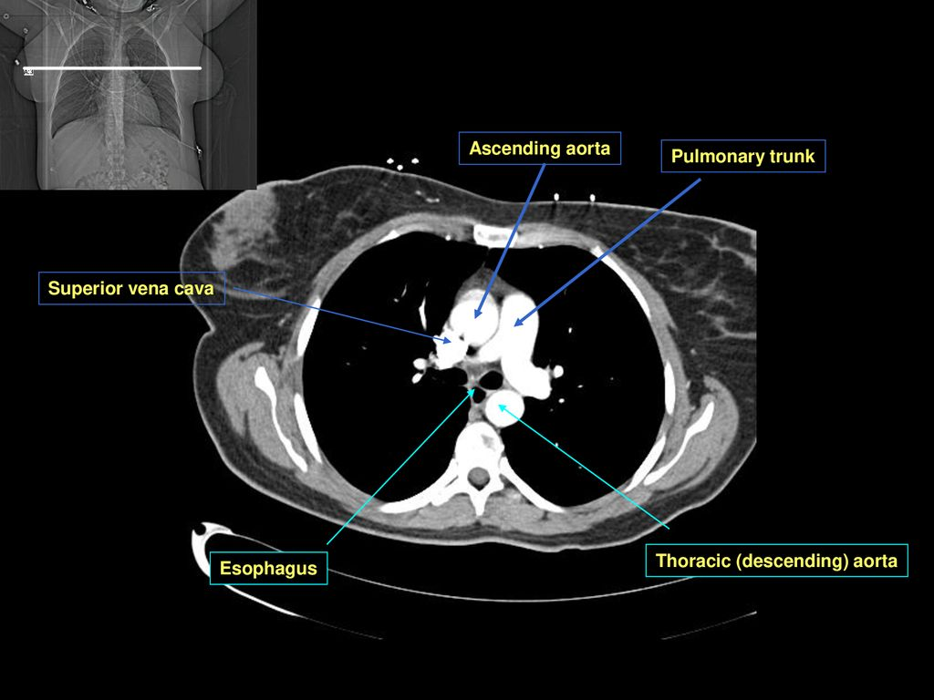
Dataset
2D axial cine MRIs prior surgery (in-vivo)
73 Acquisitions (30 slices on average)
Dilated - 58 cases
Non Dilated – 15 cases
2189 slices in total
Training set: 77% (1784 images)
Test set images: 23% (405 images)
Ground truth segmentations have been extracted by experts with the semi-automated software QIR
7
Sources: QIR software https://www.casis.fr/qir-en/ , image https://slideplayer.com/slide/15697780/88/
Clinical Background | Problem Definition | Aorta Segmentation | Evaluation | Results | GUI | Conclusions

Slide 12
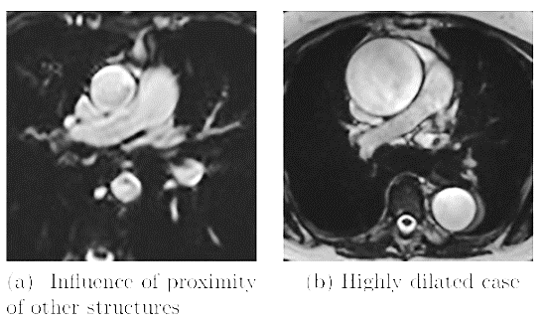
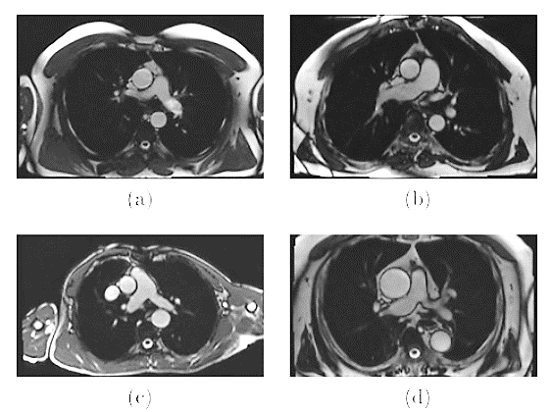
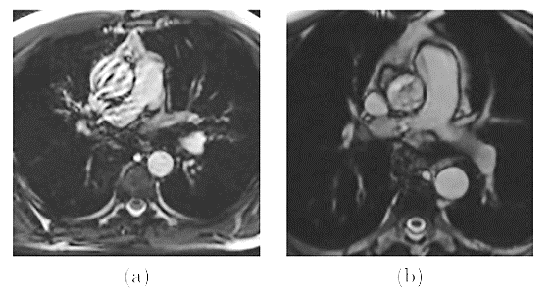
Non noisy images
Noisy images
e
f
a
b
c
d
g
h
8
Source: https://hal.archives-ouvertes.fr/hal-01670549 (edited)
Clinical Background | Problem Definition | Aorta Segmentation | Evaluation | Results | GUI | Conclusions

Slide 13
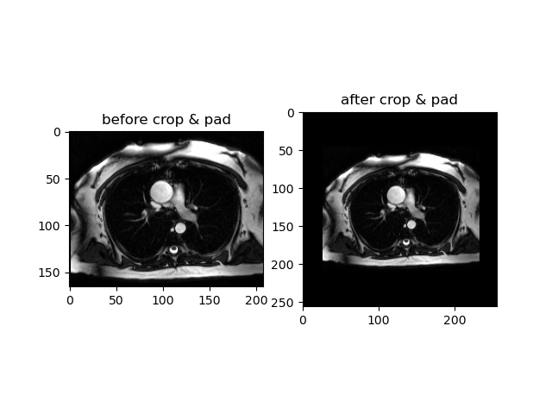
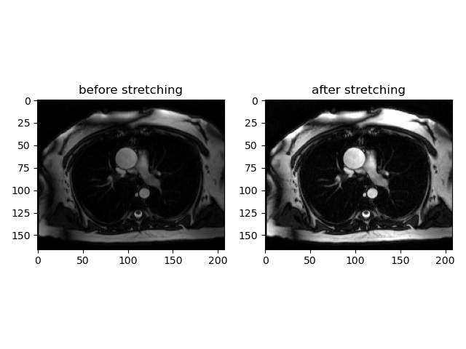
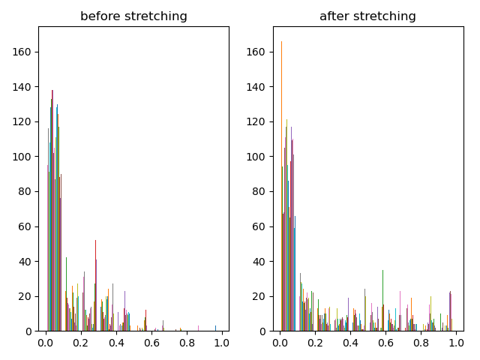
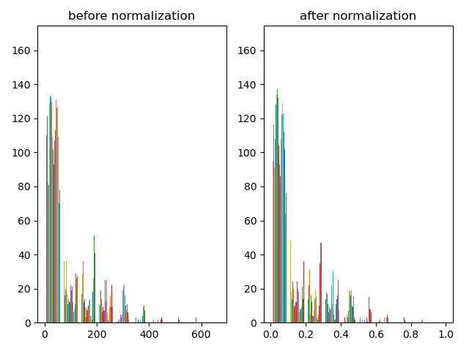
Preprocessing & Data Augmentation
Minimum – Maximum Normalization
Contrast stretching
Center cropping & zero padding
Data augmentation (50% prob)
Random rotation (20 degrees max)
Horizontal & vertical flips
Affine transformations
9
Clinical Background | Problem Definition | Aorta Segmentation | Evaluation | Results | GUI | Conclusions
Notes:
Translation ("move" image on the x-/y-axis)
Rotation
Scaling ("zoom" in/out)
Shear (move one side of the image, turning a square into a trapezoid)

Slide 14
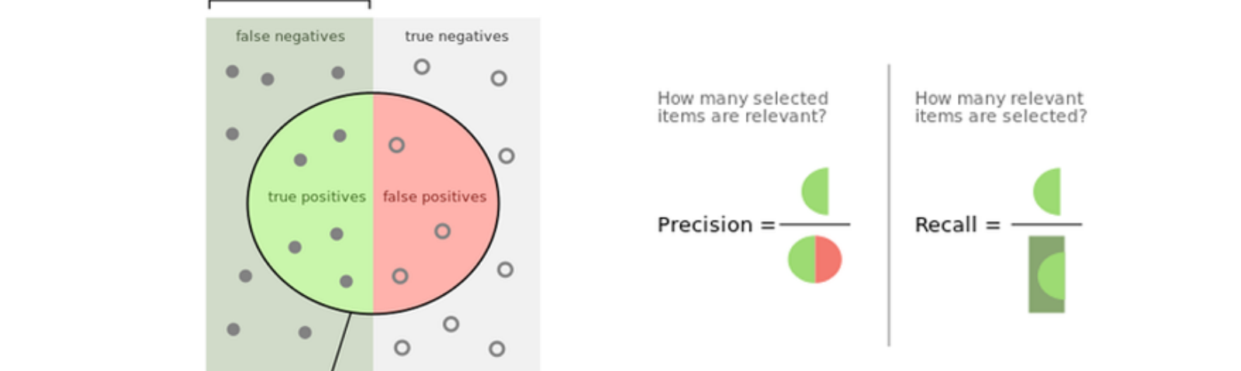
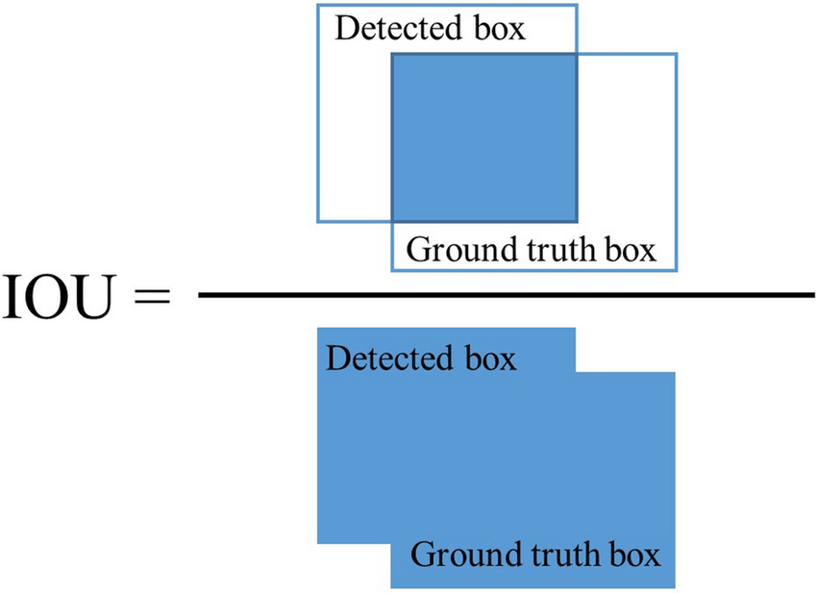
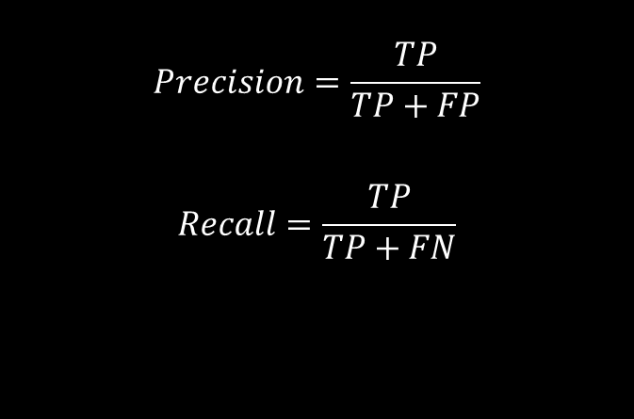
Metrics & Loss Function
$$Precision=\frac{TP}{TP+FP}$$
$$Recall=\frac{TP}{TP+FN}$$
$$Intersection over Union = \frac{TP}{TP+FP+FN}$$
10
Sources: https://www.researchgate.net/profile/Fahad-Mahdi/publication/346512249/, https://cdn-images-1.medium.com/fit/t/1600/480/1*Ub0nZTXYT8MxLzrz0P7jPA.png
Clinical Background | Problem Definition | Aorta Segmentation | Evaluation | Results | GUI | Conclusions

Slide 15
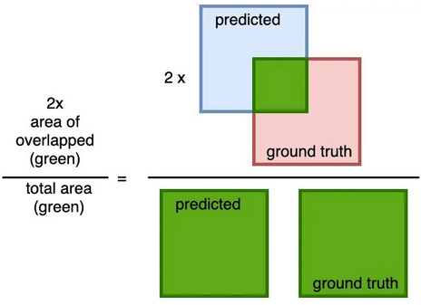
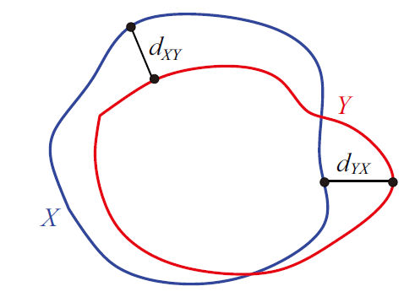
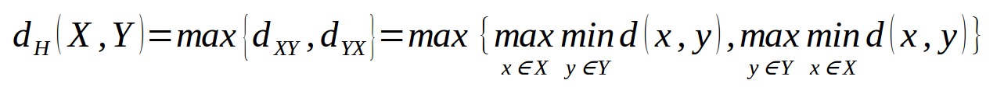

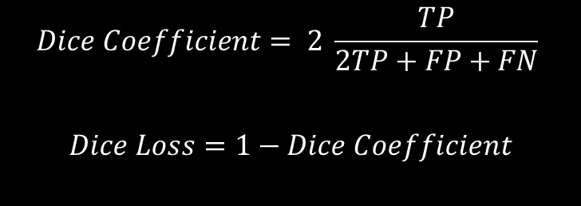
Metrics & Loss Function
$$Dice Coefficient= 2 \frac{TP}{2TP+FP+FN}$$
$$Dice Loss=1−Dice Coefficient$$
$$Hausdorff Distance$$
11
Sources: https://i.stack.imgur.com/OsH4y.png, https://rumc-gcorg-p-public.s3.amazonaws.com/i/2020/01/21/7f13e1fc.png
Clinical Background | Problem Definition | Aorta Segmentation | Evaluation | Results | GUI | Conclusions

Slide 16
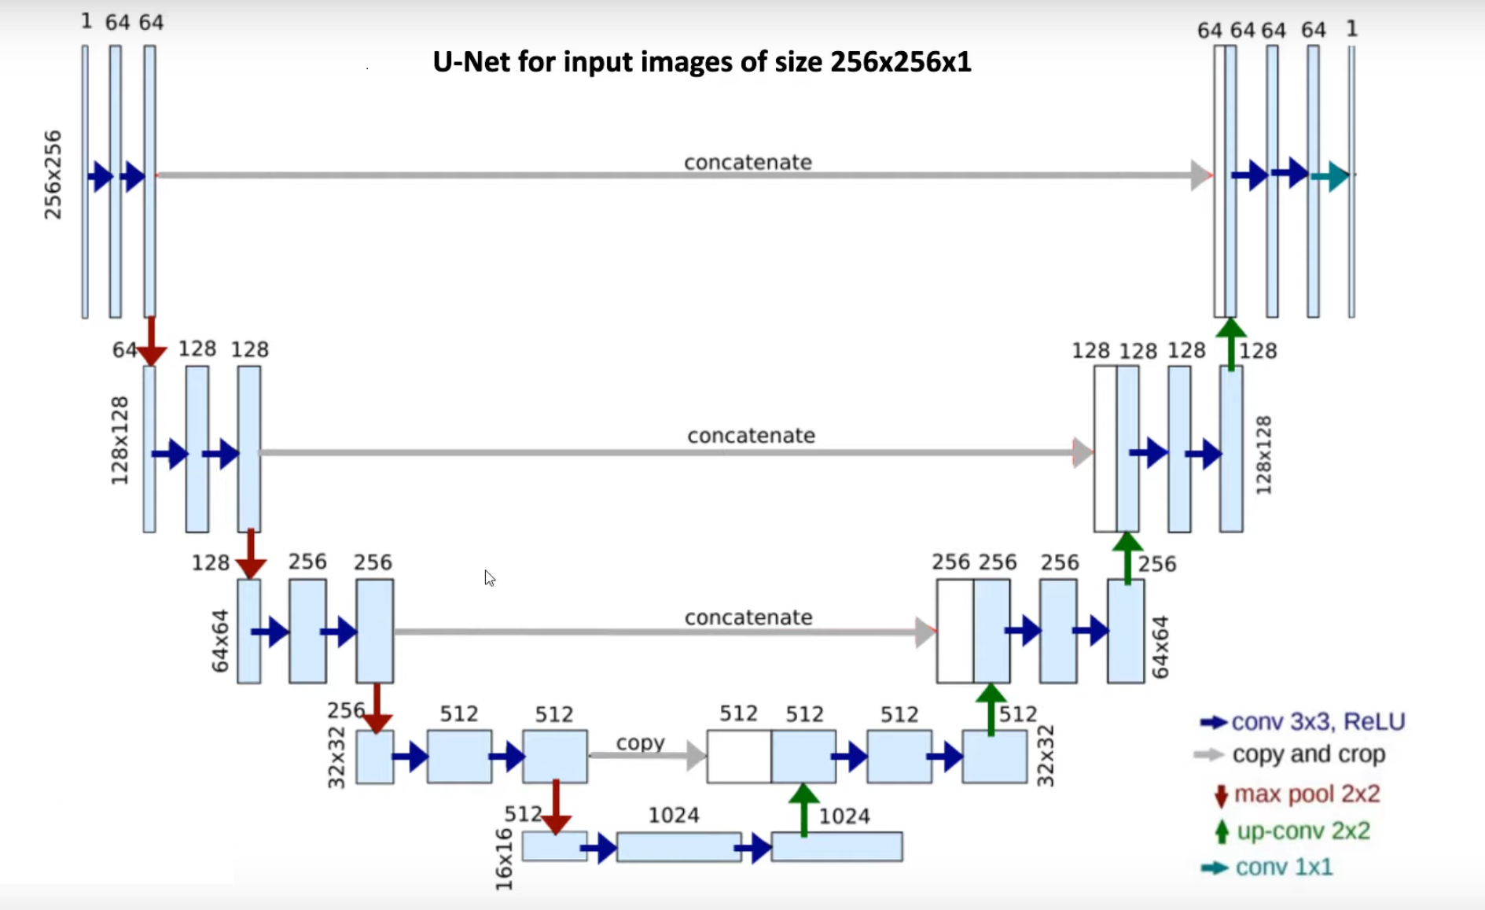
U-Net Architectures
U-Net
Residual U-Net
Attention U-Net
Attention Residual U-Net
12
Source: https://arxiv.org/abs/1505.04597 (edited)
Clinical Background | Problem Definition | Aorta Segmentation | Evaluation | Results | GUI | Conclusions
Notes:
Encoder (downsampling) – Decoder (upsampling)
Encoder produces high level feature maps
Bottleneck we lose spatial information – one dimension feature map
Decoder high level feature maps to mask (segmentation)
Using concatenation, we obtain localization information from high level feature maps of the encoder

Slide 17
Settings & Hyperparameters
Adam optimizer
Starting learning rate – [ 0.1, 0.01, 0.001, 0.0001 ]
ReduceLROnPlateau - 0.1 every 5 epochs
Minimum learning rate – 0.0000001
Layer normalization [ Instance, batch, group ]
Loss functions – [Dice Loss, Tversky Loss, Focal Loss]
K-Field Cross Validation [ 5 ]
30 to 40 epochs (maximum 2 hours training)
Early stopping epochs – [ 1, 2, 4, 8, 16 ]
13
Clinical Background | Problem Definition | Aorta Segmentation | Evaluation | Results | GUI | Conclusions

Slide 18
Evaluation

Slide 19
Metric based evaluation – with 405 test images (23% test set)
Model | Dice coef | IoU | HD (mm) | Precision | Recall
Unet | 98.09% (± 0.96%) | 96.27% (± 1.83%) | 4.88 (± 1.70) | 98.47% (± 1.45%) | 97.80% (± 1.74%)
ResUnet | 98.09% (± 0.88%) | 96.26% (± 1.68%) | 4.91 (± 1.74) | 98.28% (± 1.53%) | 97.99% (± 1.54%)
Att-Unet | 97.64% (± 1.61%) | 95.43% (± 2.85%) | 5.66 (± 2.01) | 98.62% (± 1.15%) | 96.83% (± 3.01%)
Att-Res-Unet | 98.03% (± 0.78%) | 96.14% (± 1.47%) | 5.24 (± 1.72) | 98.14% (± 1.27%) | 97.99% (± 1.64%)
Evaluation with state-of-the-art
Model | Dice coef
Our Method | 98.09% (± 0.96%)
ComboNet [1] | 92%
Hakim Fadil et al. [2] | 93%
Wenjia Bai et al. [3] | 96%
[1] Orhan Akal, Zhigang Peng, and Gerardo Hermosillo Valadez. Combonet: Combined 2d amp; 3d architecture for aorta segmentation, 2020.
[2] Hakim Fadil, John J. Totman, Derek J. Hausenloy, Hee-Hwa Ho, Prabath Joseph, Adrian Fatt-Hoe Low, A. Mark Richards, Mark Y. Chan, and Stephanie Marchesseau. A deep learning pipeline for automatic analysis of multi-scan cardiovascular magnetic resonance. Journal of Cardiovascular Magnetic Resonance, 23(1), April 2021.
[3] Wenjia Bai, Hideaki Suzuki, Chen Qin, Giacomo Tarroni, Ozan Oktay, Paul M. Matthews, and Daniel Rueckert. Recurrent neural networks for aortic image sequence segmentation with sparse annotations. CoRR, abs/1808.00273, 2018
14
Clinical Background | Problem Definition | Aorta Segmentation | Evaluation | Results | GUI | Conclusions
Notes:
is not easily comparable, because this is not the same dataset, and not the same technique. It is just to have an idea.

Slide 20
Results

Slide 21
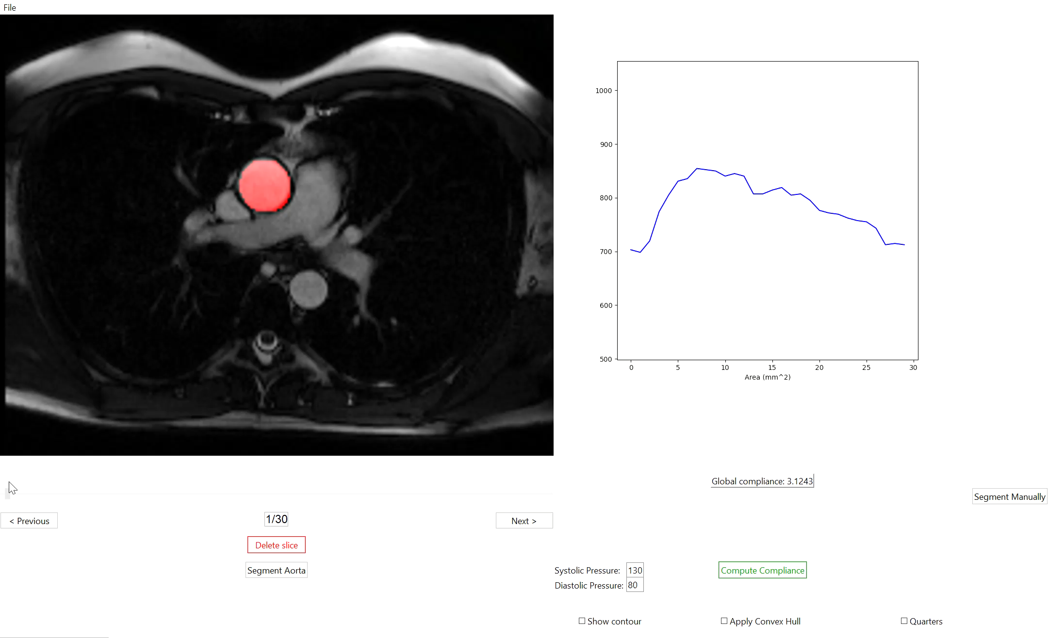
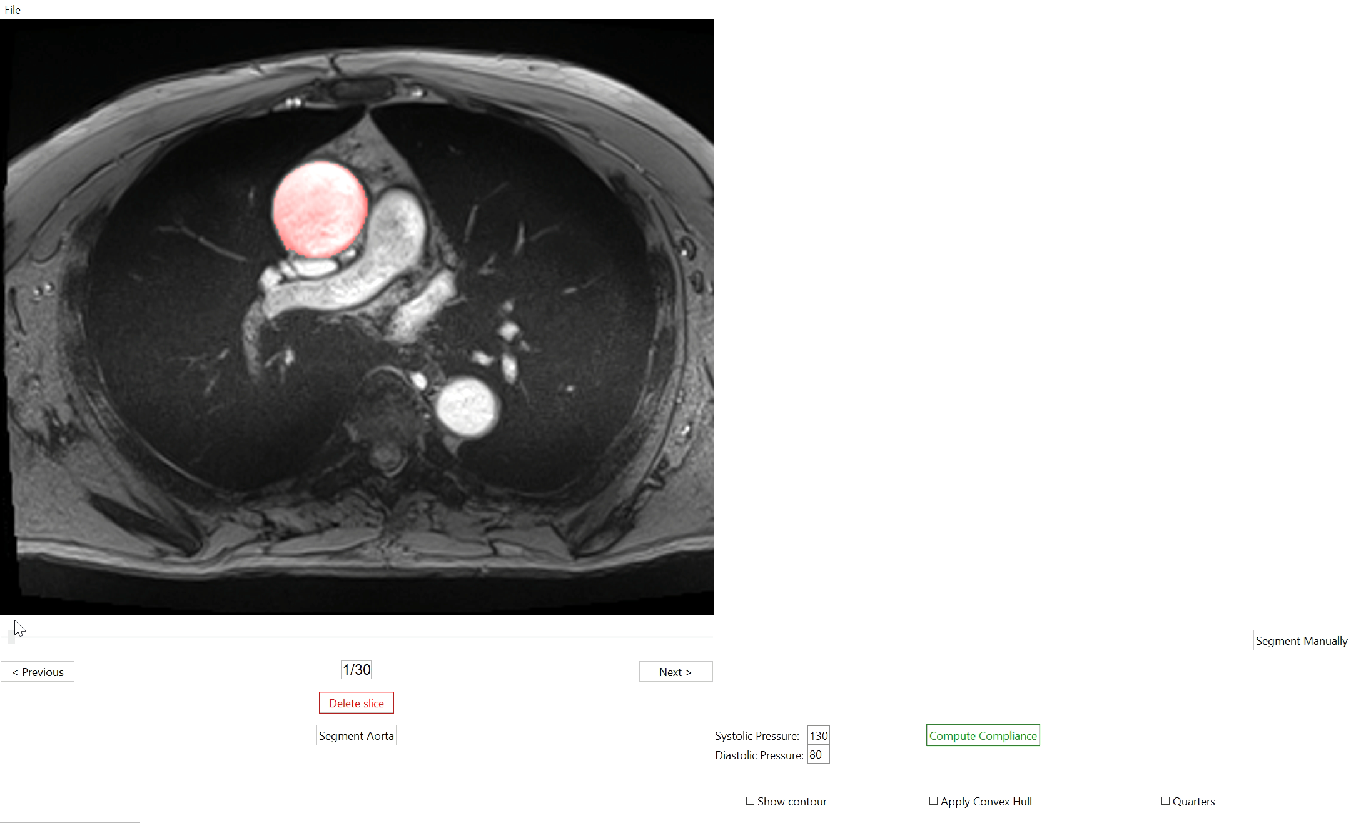
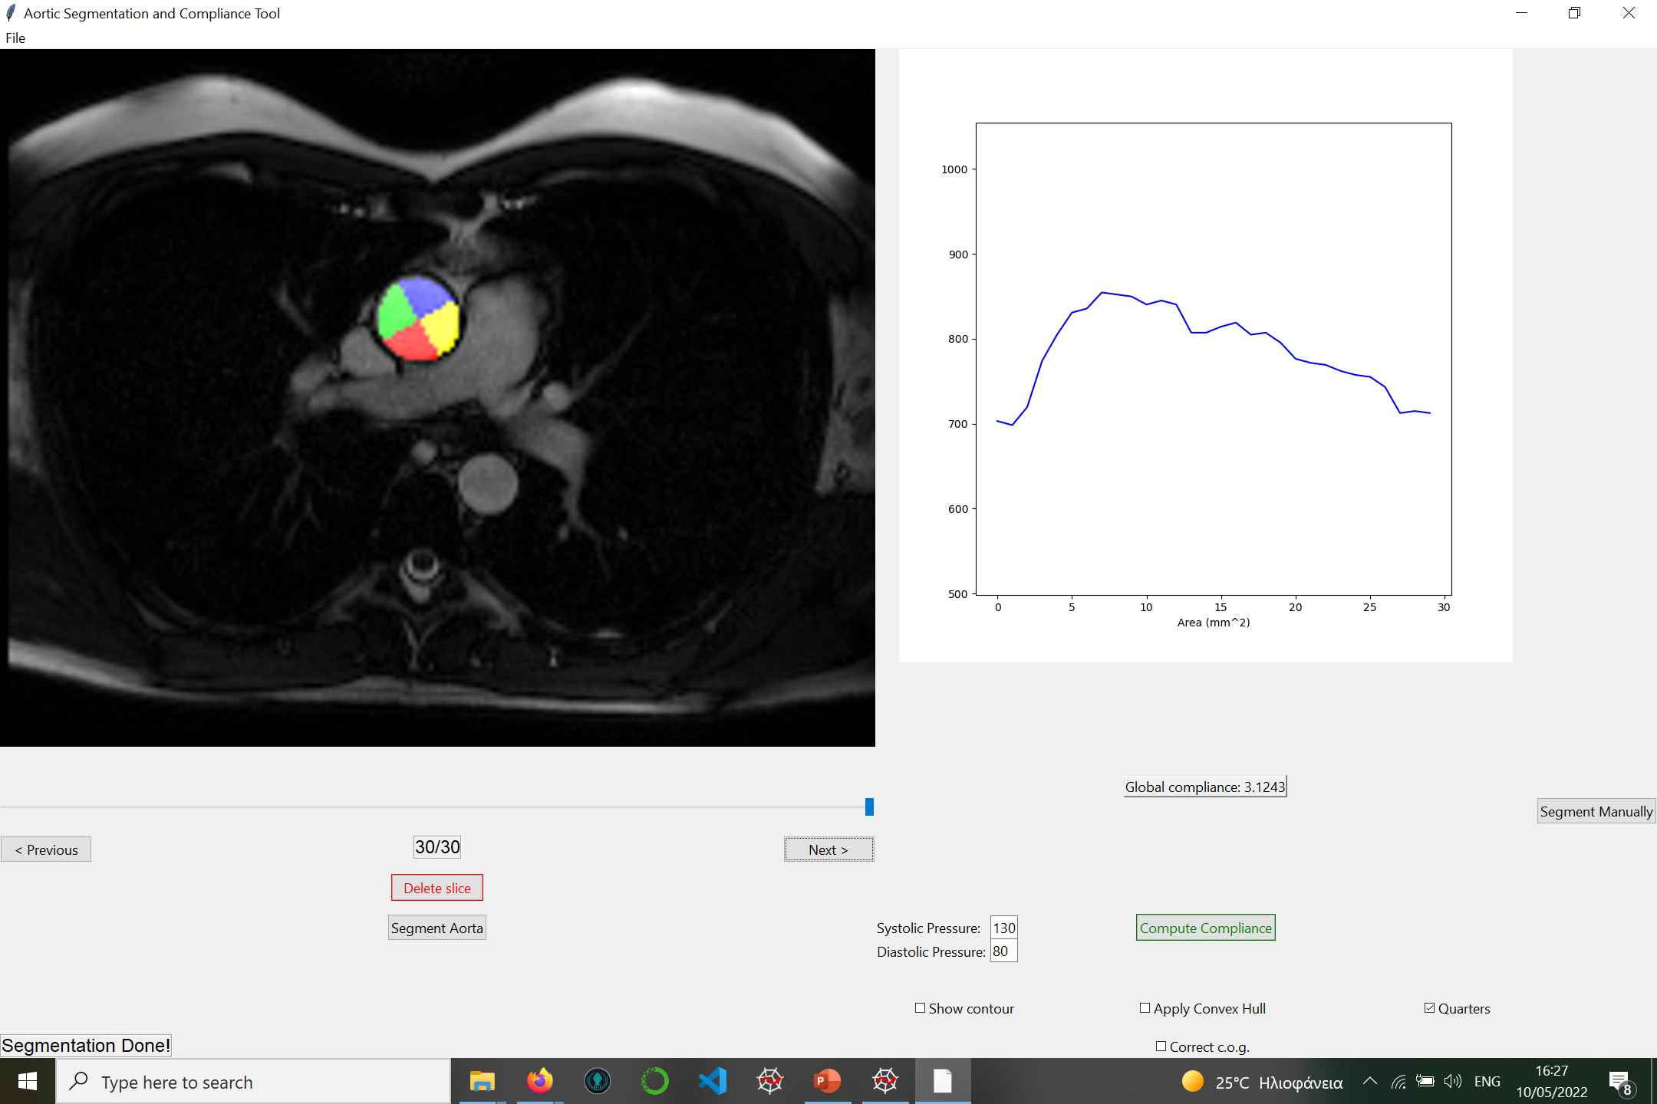
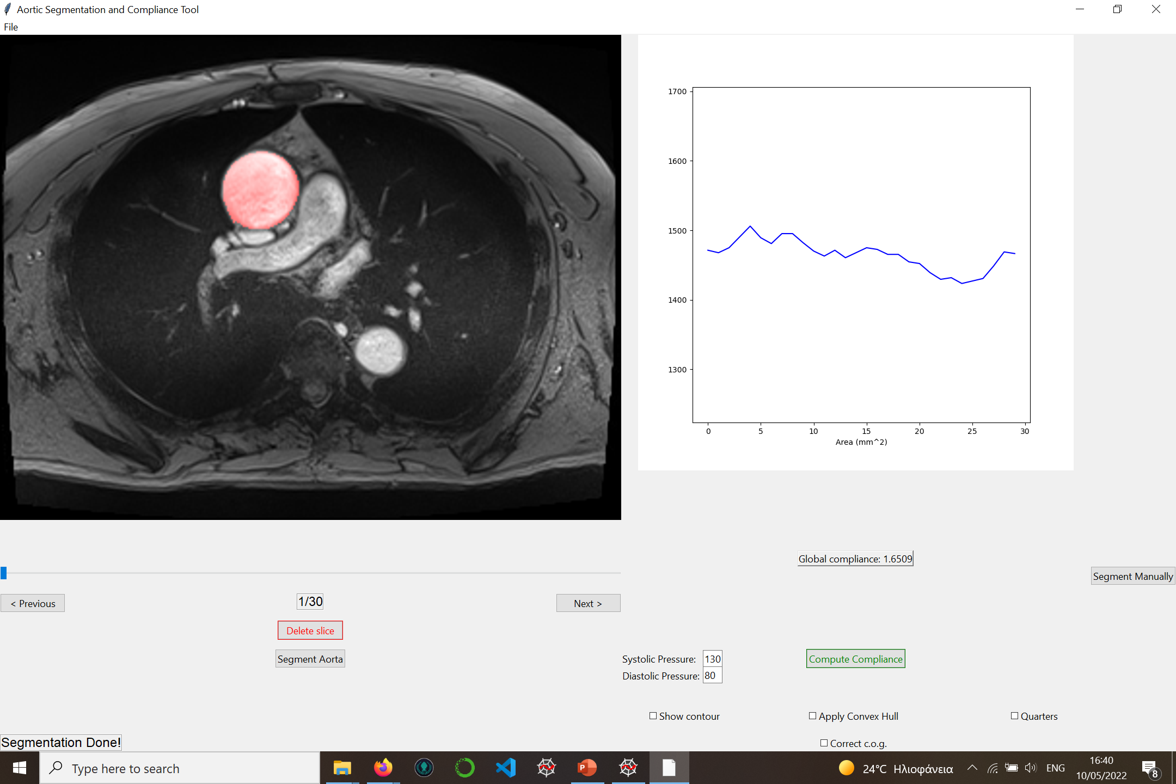
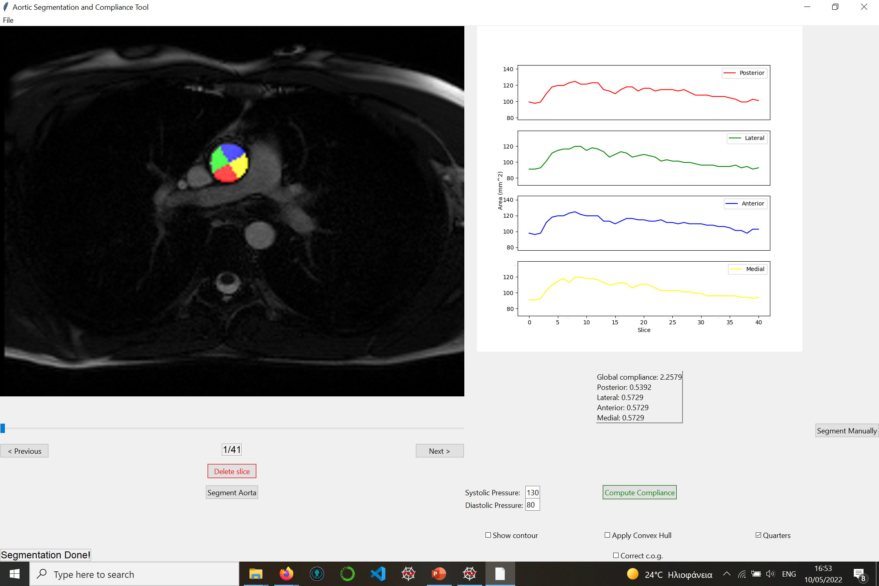
Non dilated aorta – with high elasticity
Dilated aorta – with low elasticity
Global compliance = 2.26 mm²/mmHg
Global compliance = 1.65 mm²/mmHg
15
Clinical Background | Problem Definition | Aorta Segmentation | Evaluation | Results | GUI | Conclusions

Slide 22
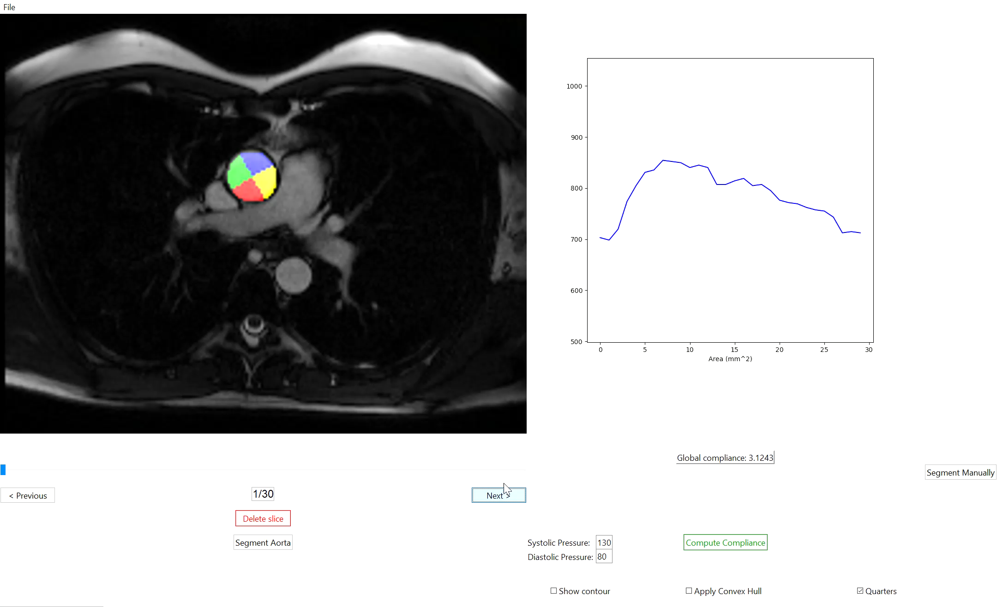
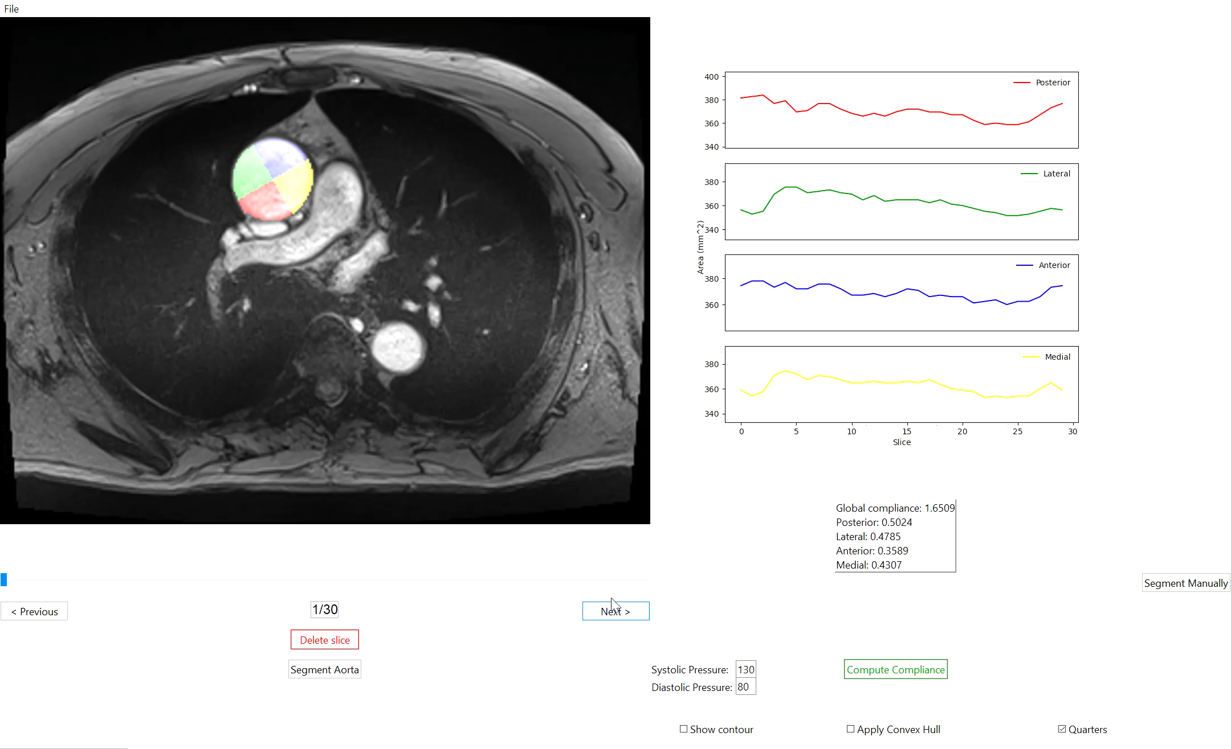
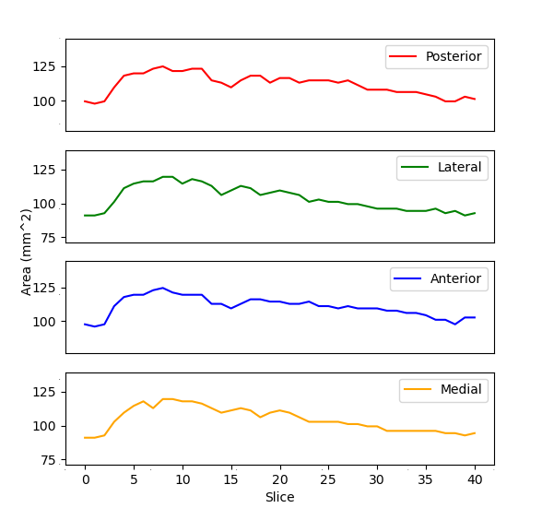
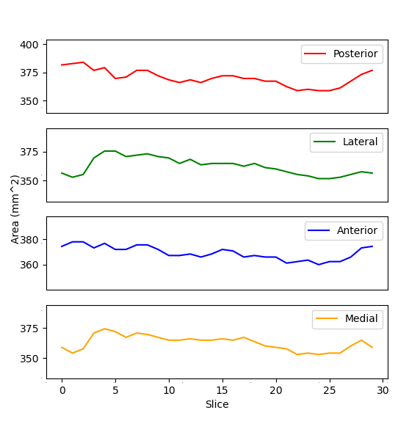
Non dilated aorta – with high elasticity
Dilated aorta – with low elasticity
compliance = 0.54
compliance = 0.50
compliance = 0.57
compliance = 0.48
compliance = 0.57
compliance = 0.35
compliance = 0.57
compliance = 0.43
16
Clinical Background | Problem Definition | Aorta Segmentation | Evaluation | Results | GUI | Conclusions

Slide 23
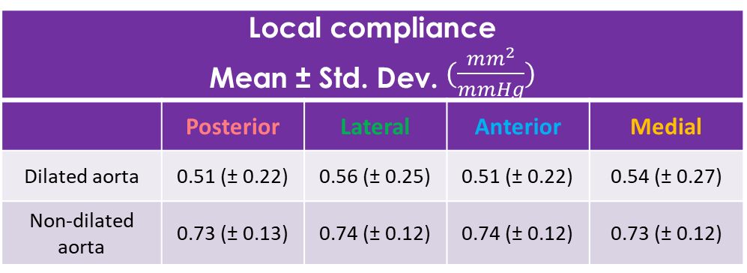

Compliance
Predictions – Ground Truth Correlation
 | Dilated aorta | Non-dilated aorta
Min Area | 0.99 | 0.99
Max Area | 0.99 | 0.99
Compliance | 0.79 | 0.93
Local compliance Mean ± Std. Dev. $(\frac{mm^{2}}{mmHg})$
 | Posterior | Lateral | Anterior | Medial
Dilated aorta | 0.51 (± 0.22) | 0.56 (± 0.25) | 0.51 (± 0.22) | 0.54 (± 0.27)
Non-dilated aorta | 0.73 (± 0.13) | 0.74 (± 0.12) | 0.74 (± 0.12) | 0.73 (± 0.12)
$Compliance=\frac{Maximum area −Minimum area }{Systolic pressure −Diastolic pressure}$ $(\frac{mm^{2}}{mmHg})$
17
Clinical Background | Problem Definition | Aorta Segmentation | Evaluation | Results | GUI | Conclusions

Slide 24
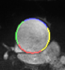

Strain
Metric to measure stiffness (in-vivo and ex-vivo)
For ex-vivo testing physicians compare the length of stretched and rested aortic wall $\text{ε}=\frac{l −l_{0}}{l_{0}}$
For in-vivo testing we compare local perimeters
Strain Mean ± Std. Dev.
 | Posterior | Lateral | Anterior | Medial
Dilated aorta | 0.112 (± 0.08) | 0.093 (± 0.05) | 0.084 (± 0.05) | 0.086 (± 0.04)
Non-dilated aorta | 0.266 (± 0.07) | 0.25 (± 0.07) | 0.246 (± 0.05) | 0.249 (± 0.09)
$$Strain=\frac{MaximumPerimeter −MinimumPerimeter}{MinimumPerimeter}$$
18
Clinical Background | Problem Definition | Aorta Segmentation | Evaluation | Results | GUI | Conclusions
Notes:
We consider again the center of gravity
Minimum and maximum perimeter are the length of the arc
Applying a load F to elastic materials can result in a change in length l.
The engineering strain ε is the length variation in its vertical direction.

Slide 25
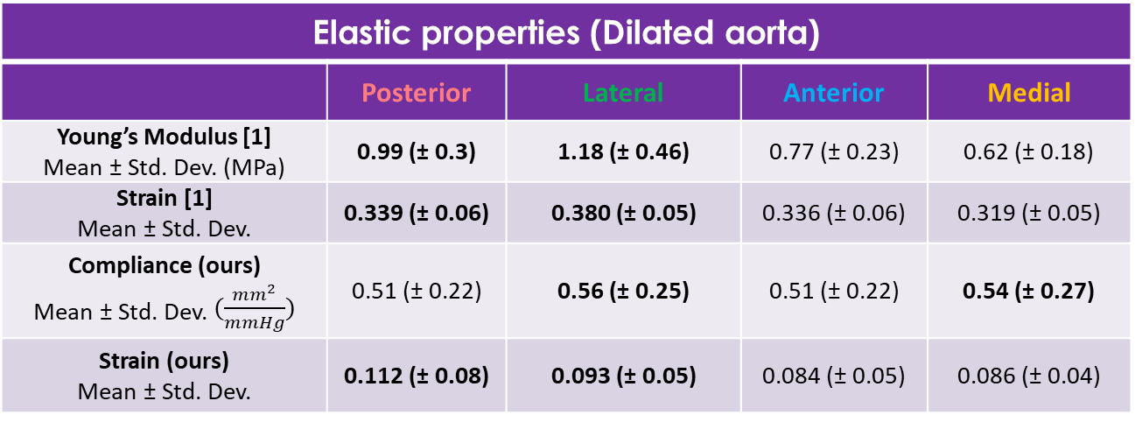
Comparison with ex-vivo results
Elastic properties (Dilated aorta)
 | Posterior | Lateral | Anterior | Medial
Young’s Modulus [1] Mean ± Std. Dev. (MPa) | 0.99 (± 0.3) | 1.18 (± 0.46) | 0.77 (± 0.23) | 0.62 (± 0.18)
Strain [1] Mean ± Std. Dev. | 0.339 (± 0.06) | 0.380 (± 0.05) | 0.336 (± 0.06) | 0.319 (± 0.05)
Compliance (ours) Mean ± Std. Dev. $(\frac{mm^{2}}{mmHg})$ | 0.51 (± 0.22) | 0.56 (± 0.25) | 0.51 (± 0.22) | 0.54 (± 0.27)
Strain (ours) Mean ± Std. Dev. | 0.112 (± 0.08) | 0.093 (± 0.05) | 0.084 (± 0.05) | 0.086 (± 0.04)
Comparison of elastic properties between our results and the results from the work of Lin et al. [1]. We use only 22 cases from the ex-vivo dataset for this table, where the patients are common with our dataset of dilated cases.
19
Source: [1] Lin S, Morgant M, Marın-Castrillon D, Walker P, Serge Aho Gele L, Boucher A, Presles B, Bouchot O, and Lalande A. Aortic local biomechanical properties in the ascending aortic aneurysms (under review). ACTA Biomaterialia, 2022.
Clinical Background | Problem Definition | Aorta Segmentation | Evaluation | Results | GUI | Conclusions

Slide 26
Graphical User Interface

Slide 27
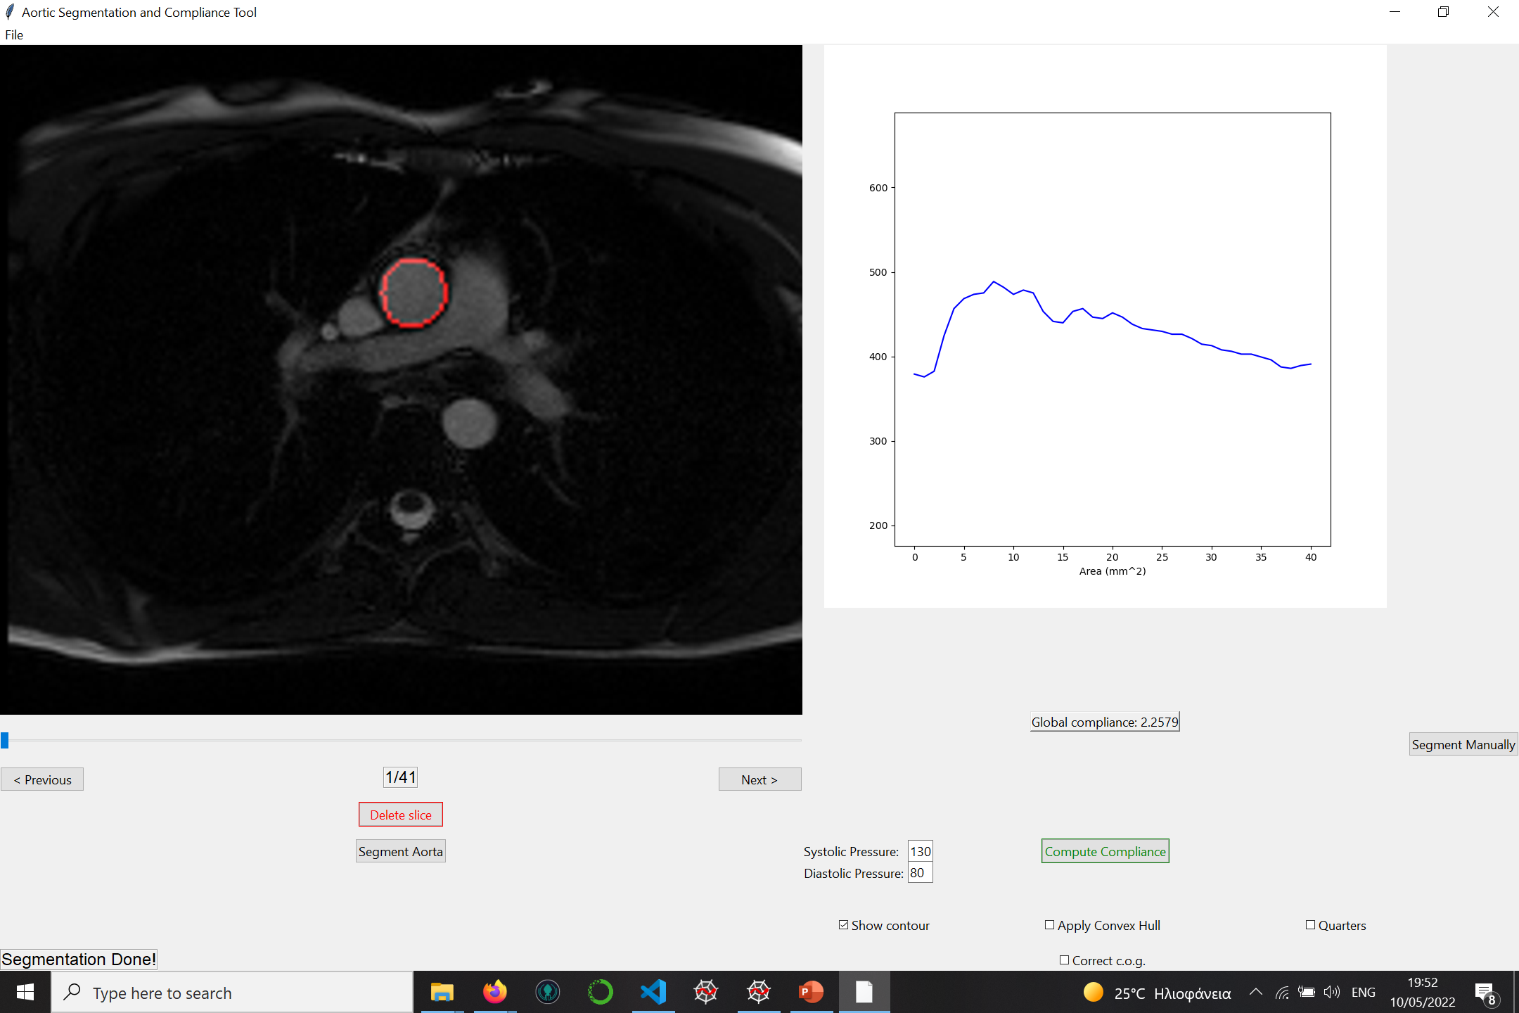
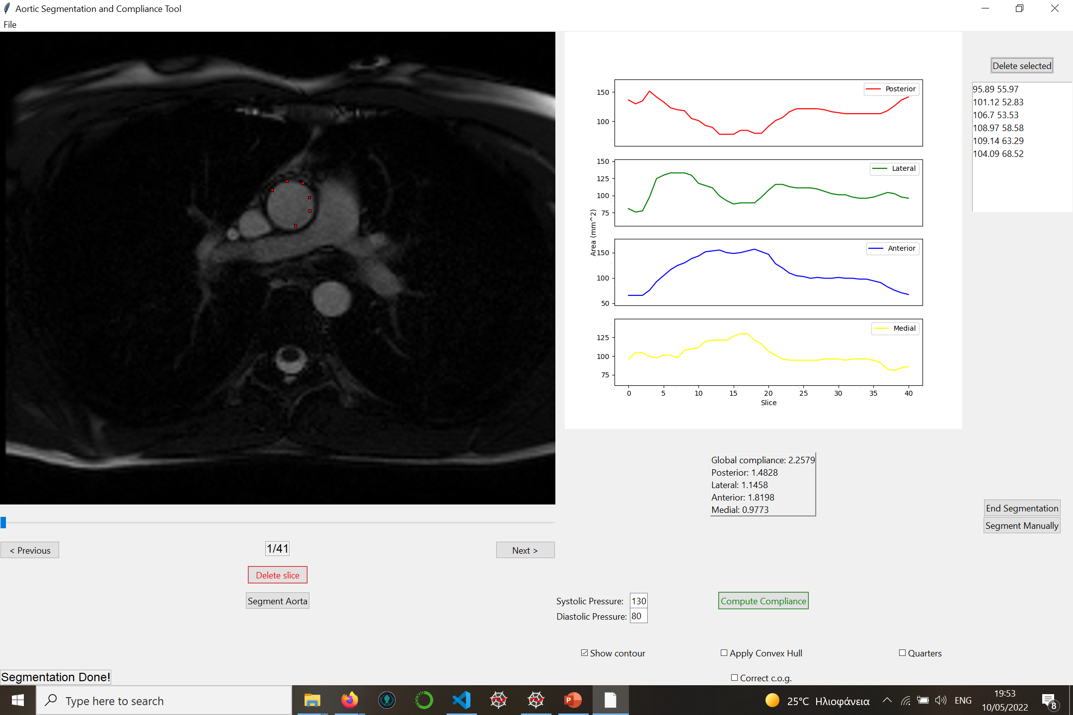
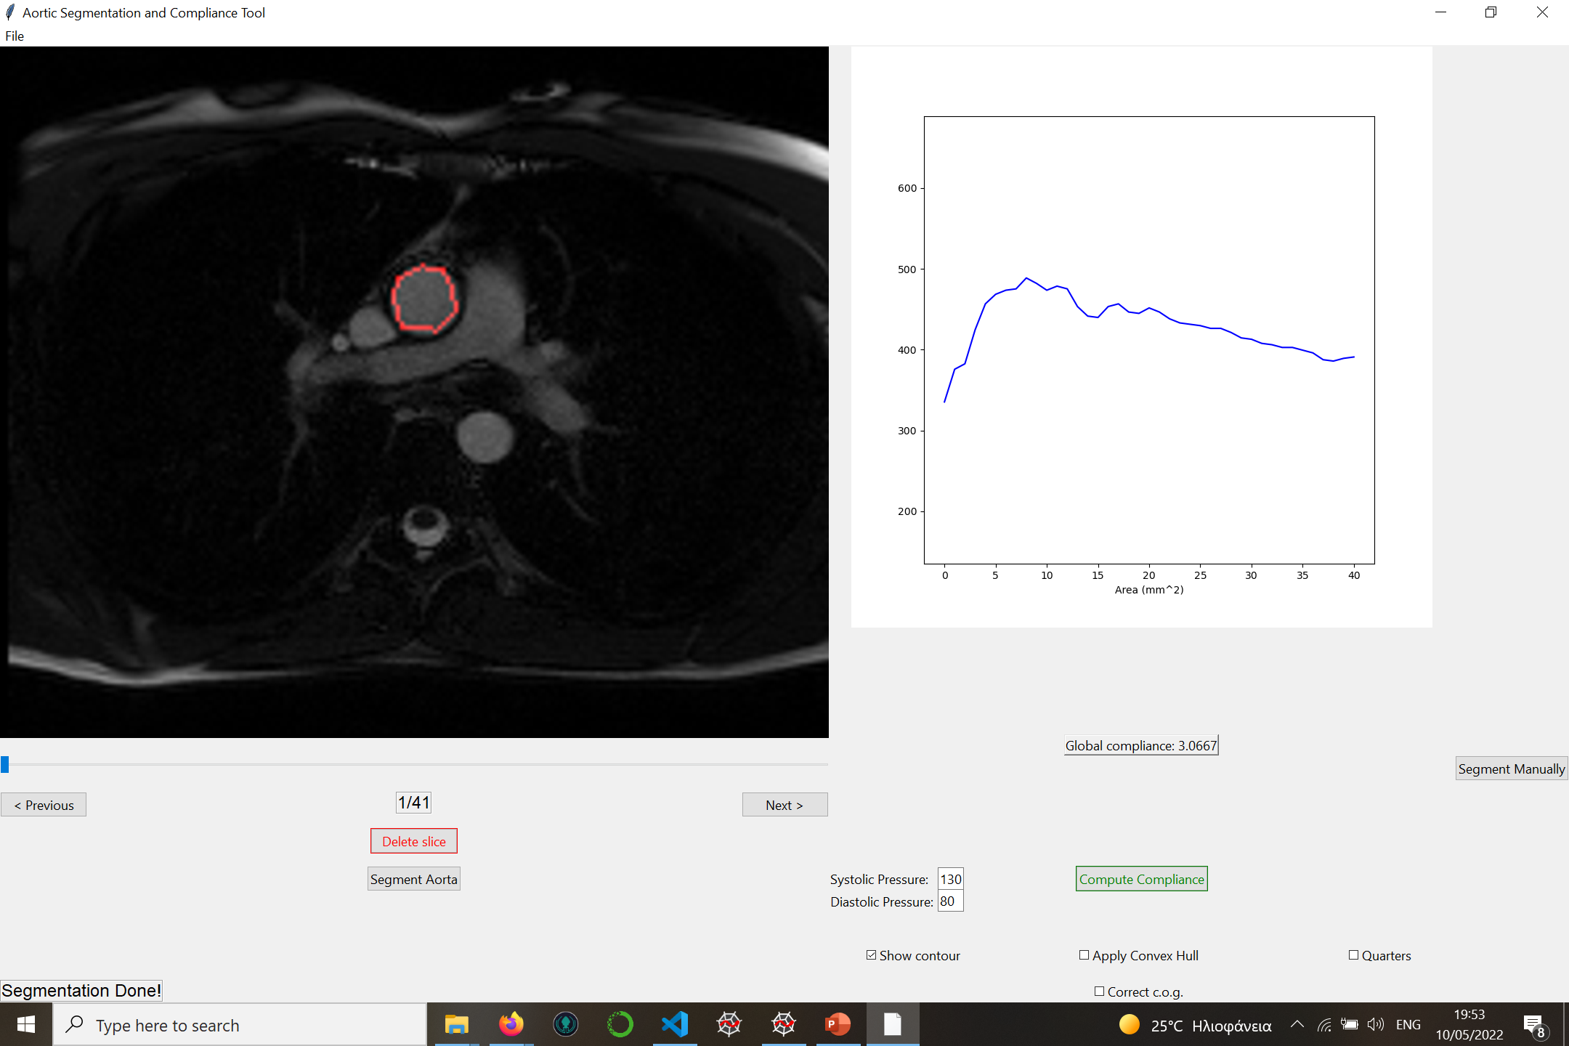
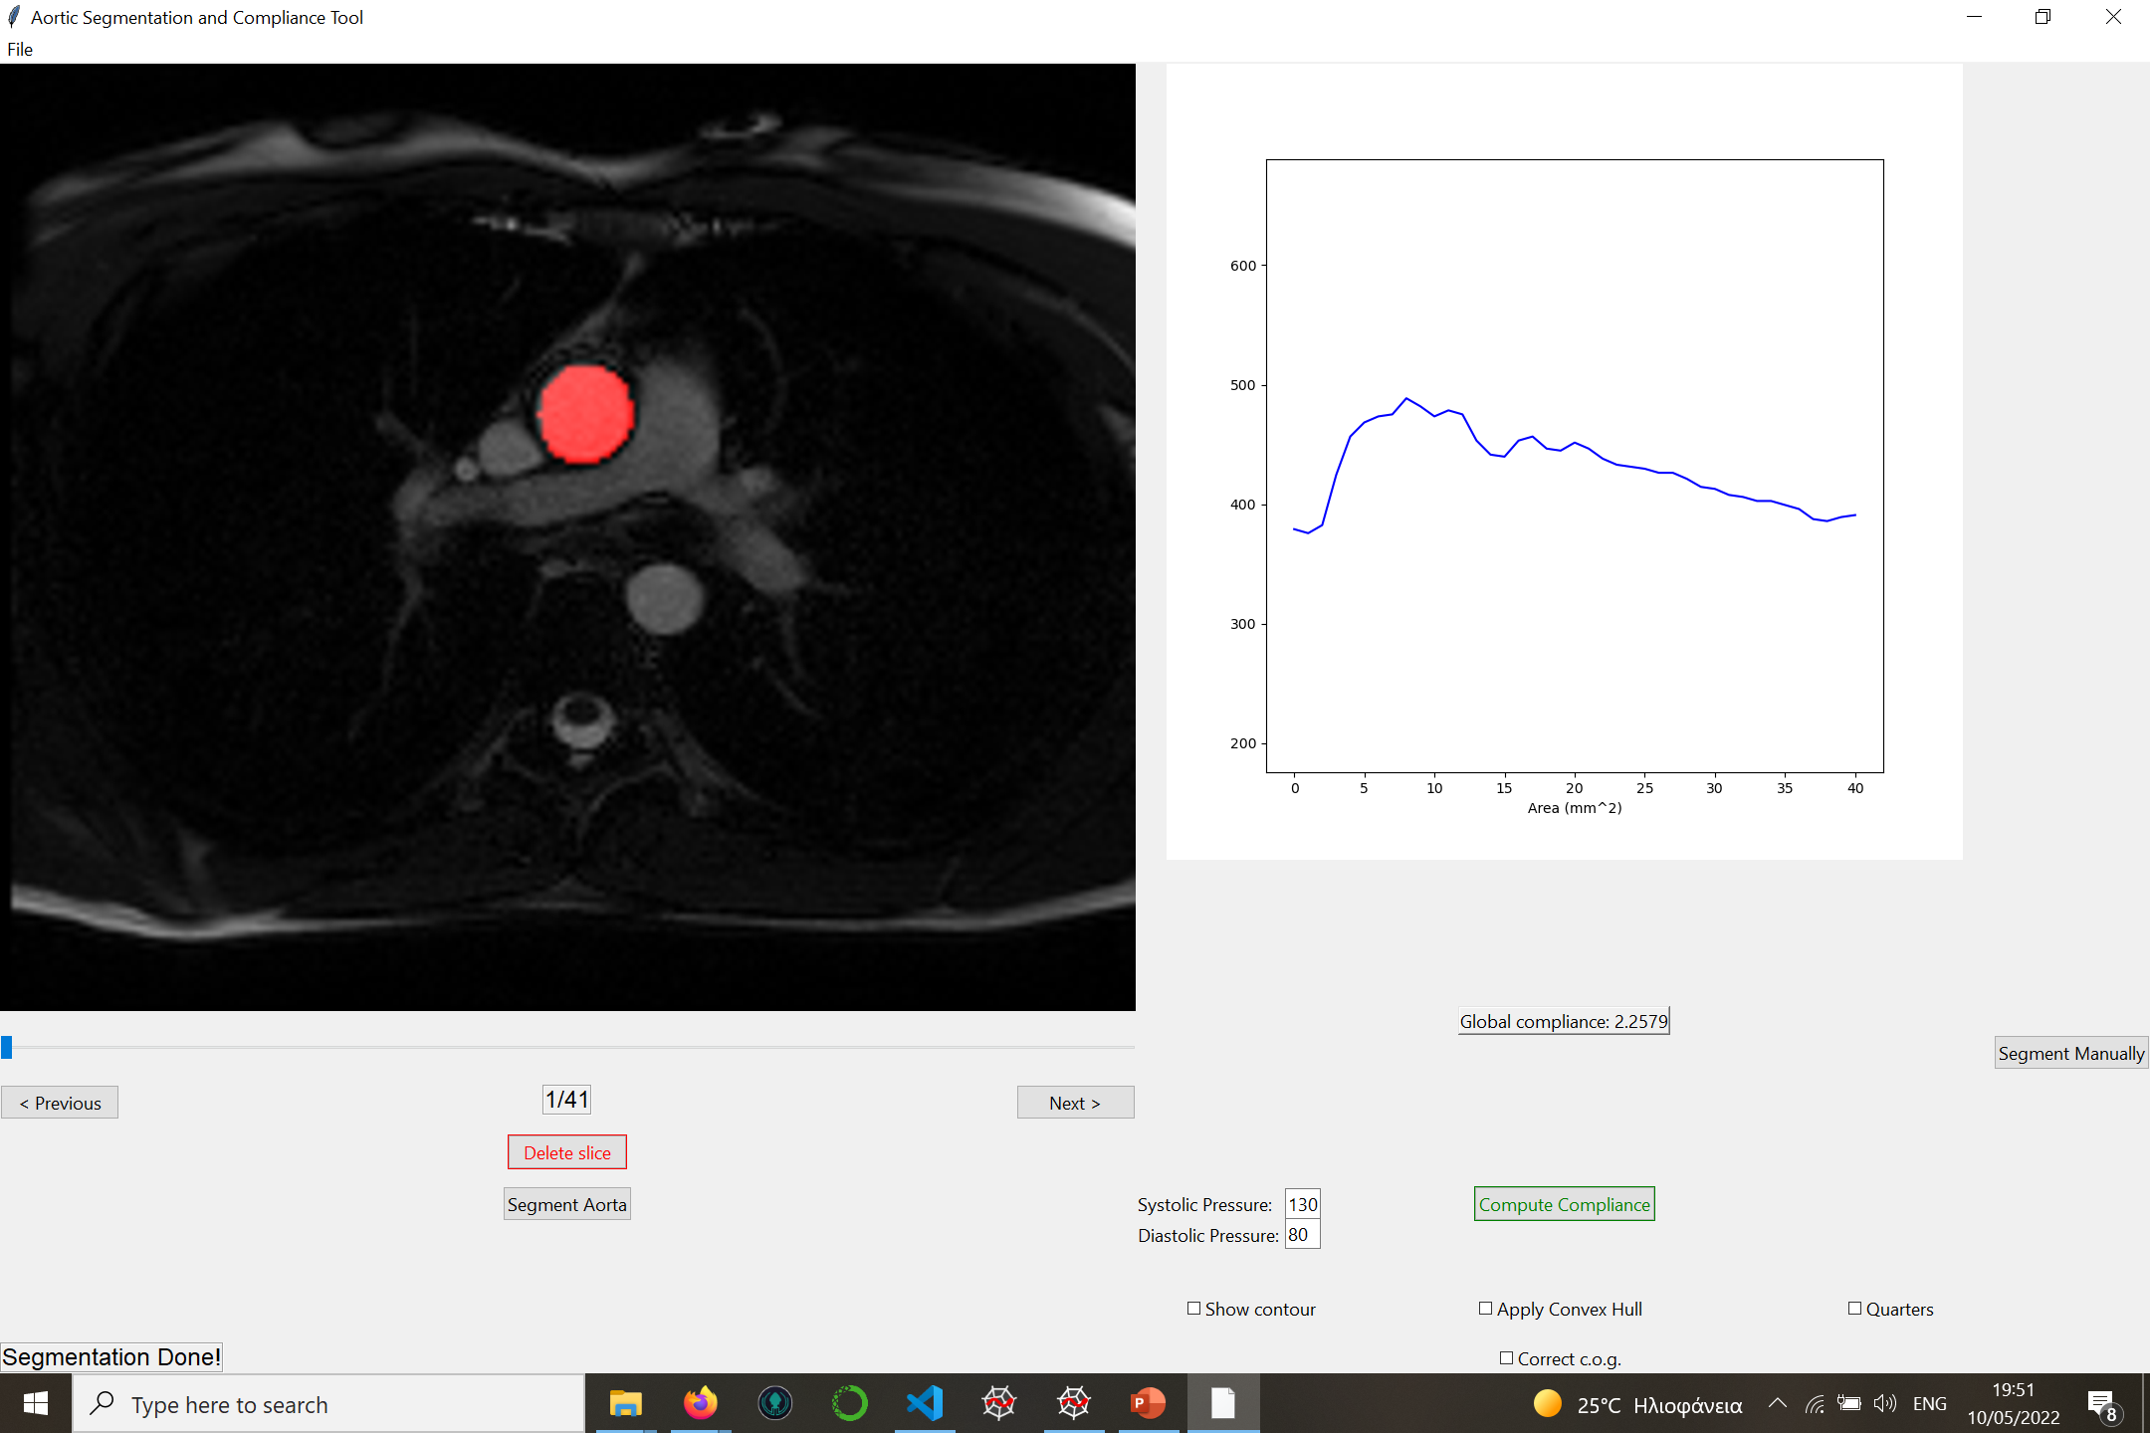
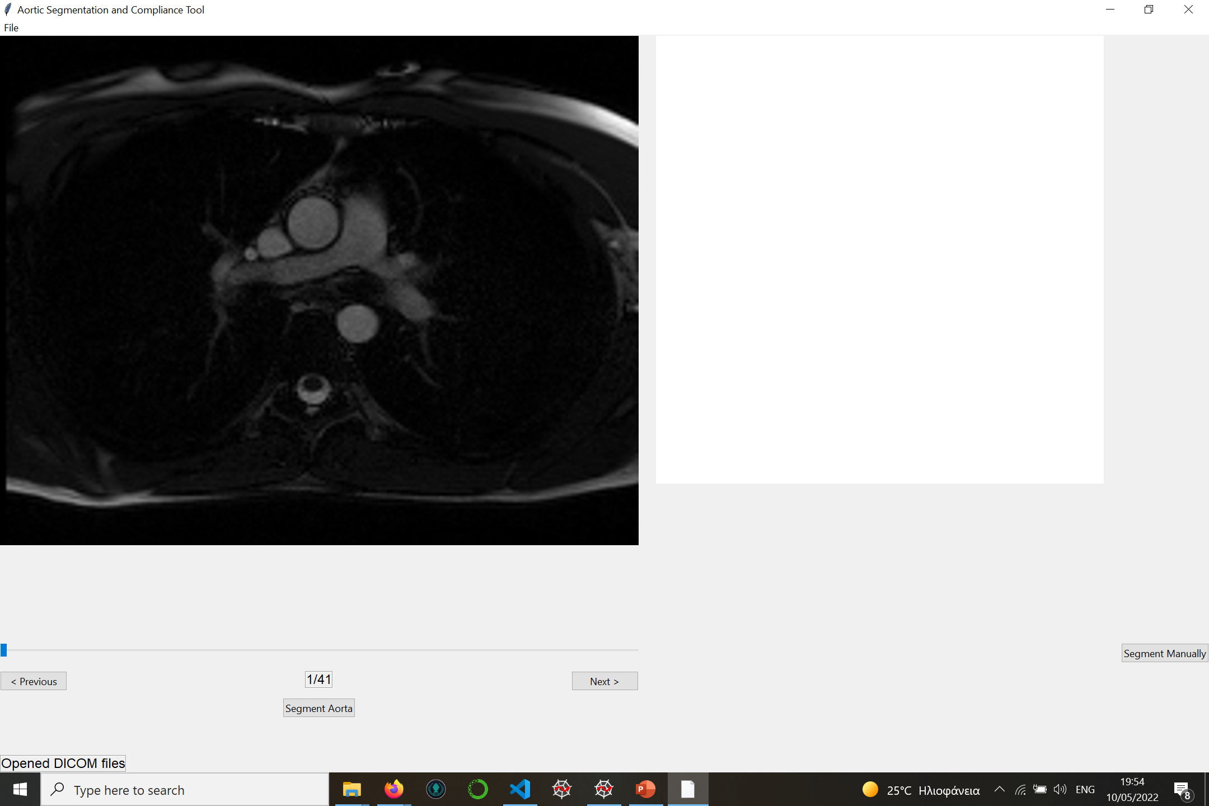
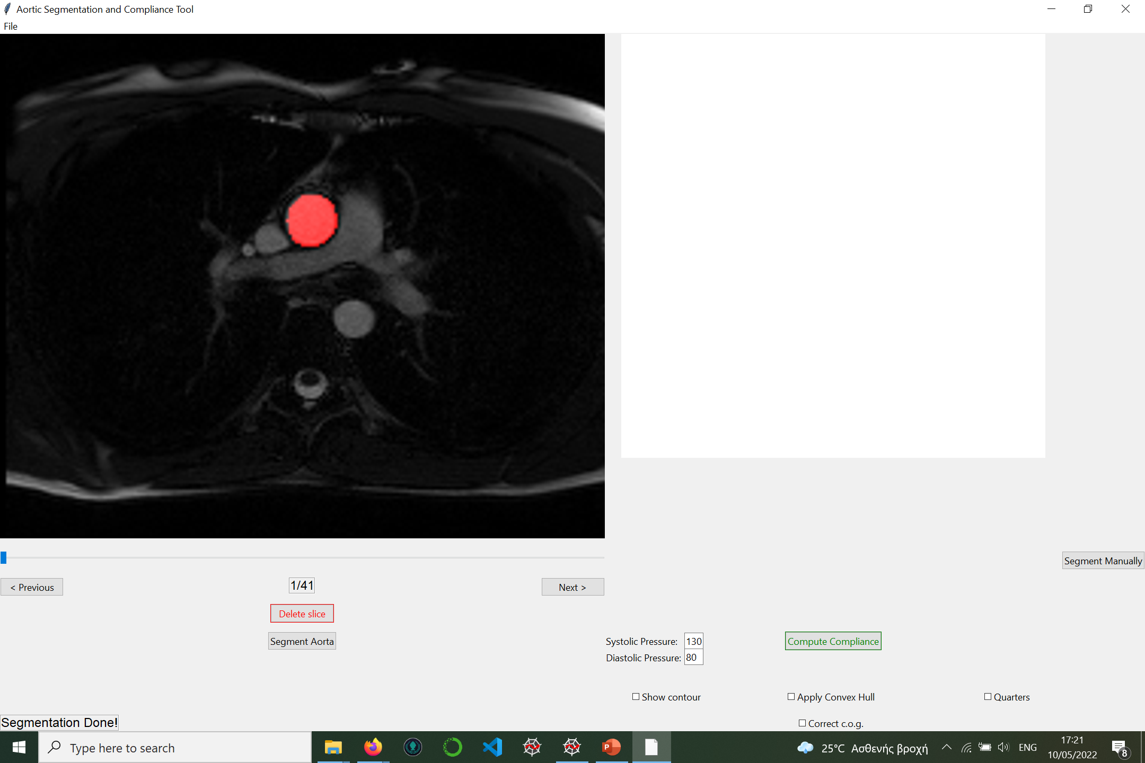
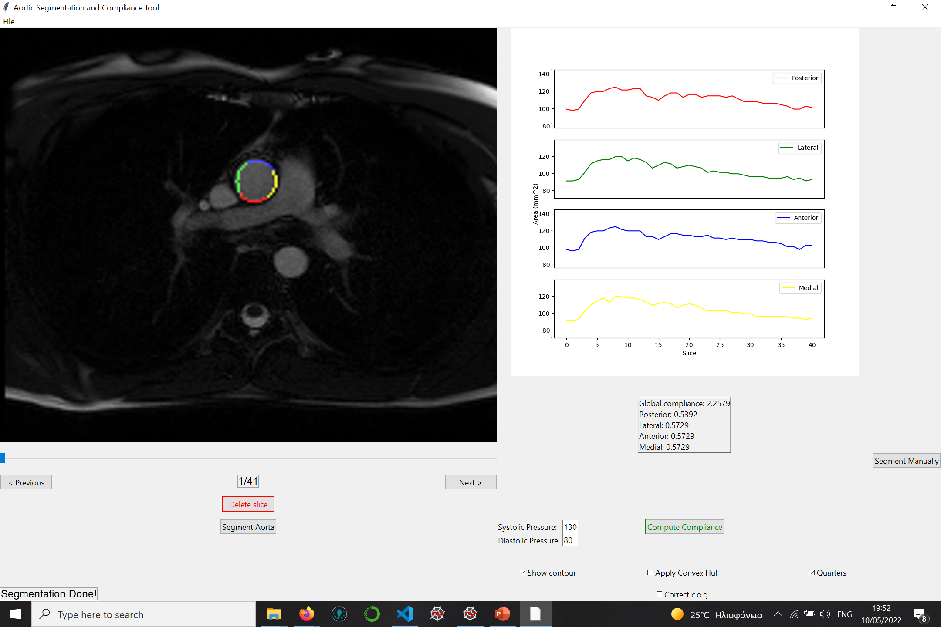
20
Clinical Background | Problem Definition | Aorta Segmentation | Evaluation | Results | GUI | Future Work
Clinical Background | Problem Definition | Aorta Segmentation | Evaluation | Results | GUI | Conclusions

Slide 28
Conclusions & Future Work

Slide 29
Conclusions
UNet performs robust segmentation results
Important correlation with reference data(min, max)
Local compliance is a questionable metric
High correlation with in-vivo and ex-vivo results
21
Clinical Background | Problem Definition | Aorta Segmentation | Evaluation | Results | GUI | Conclusions

Slide 30
In-vivo evaluation of aortic elastic properties is mandatory, prior a surgery.
Until now, stiffness can be measured only after surgery (ex-vivo). Our work contribute to the process of making a connection from ex-vivo properties to in-vivo ones.
Assessing stiffness in-vivo would be useful before surgery.
22
Clinical Background | Problem Definition | Aorta Segmentation | Evaluation | Results | GUI | Conclusions

Slide 31
Future Work
Improve models performance by adding more images
Explore more architectures
Improve robustness & stability of the GUI
23
Clinical Background | Problem Definition | Aorta Segmentation | Evaluation | Results | GUI | Conclusions

Slide 32

Q&A
Thank you!

Slide 33
Automatic calculation of the local aortic compliance from thoracic cine-MRI
Manos MARKODIMITRAKIS
Supervisor: Alain LALANDE

Slide 34
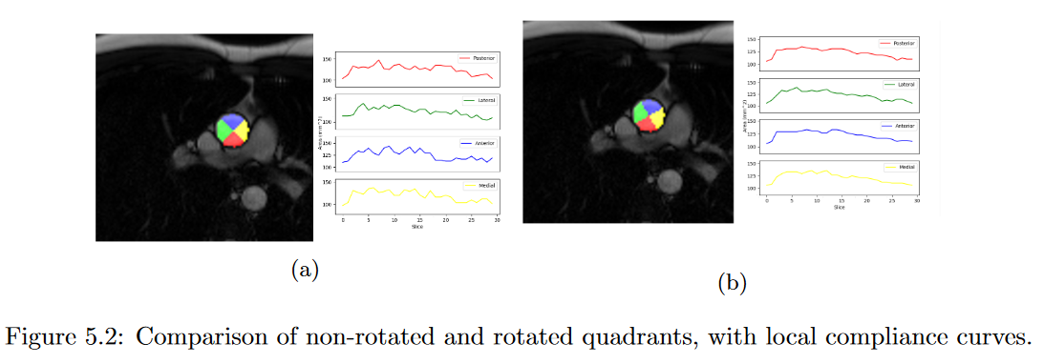
Division to quadrants
45 degrees rotation
60 degrees rotation
y-axis
y-axis
Posterior
Posterior
Lateral
Lateral
x-axis
x-axis
Anterior
Anterior
Medial
Medial
Clinical Background | Problem Definition | Aorta Segmentation | Evaluation | Results | GUI | Future Work

Slide 35
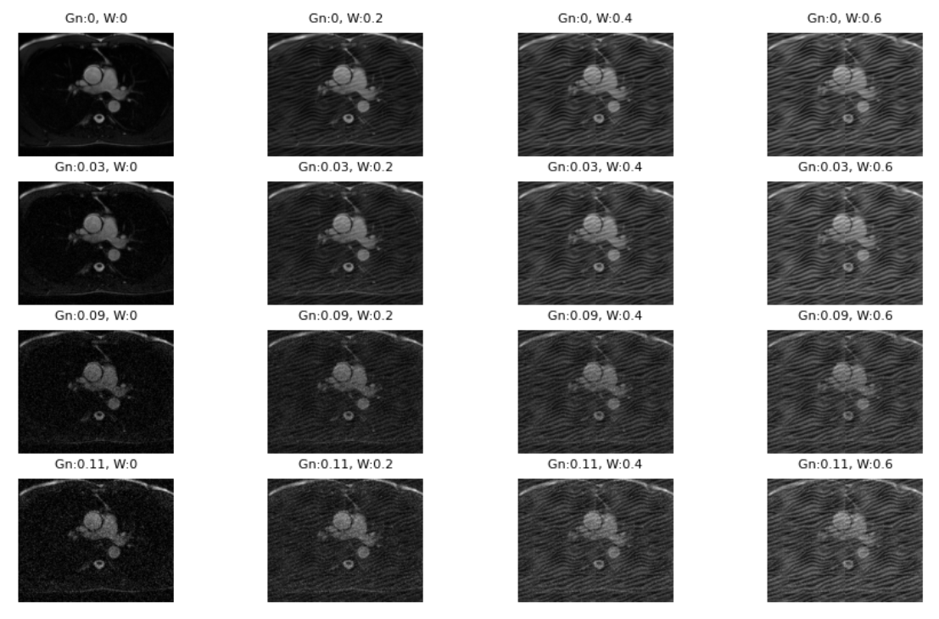
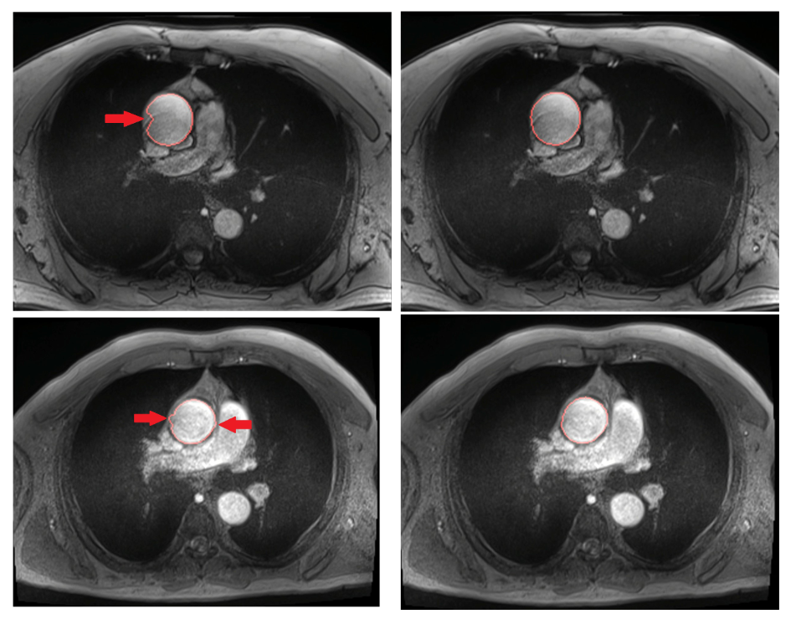
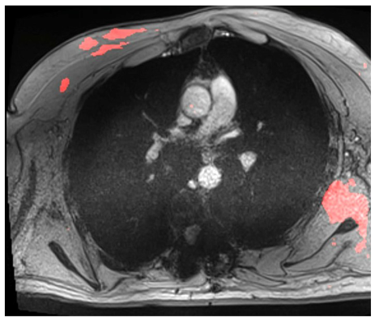
Data augmentation
Extreme cases
Clinical Background | Problem Definition | Aorta Segmentation | Evaluation | Results | GUI | Future Work

Slide 36

Compliance - Bland Altman Plot
Clinical Background | Problem Definition | Aorta Segmentation | Evaluation | Results | GUI | Future Work

Slide 37


Min & Max area- Bland Altman Plot
Clinical Background | Problem Definition | Aorta Segmentation | Evaluation | Results | GUI | Future Work

Slide 38

Post Processing (optional)
Convex hull
No need for fill holes
Discard outliers
Source: https://ars.els-cdn.com/content/image/3-s2.0-B9781785482434500050-f05-07-9781785482434.jpg
Clinical Background | Problem Definition | Aorta Segmentation | Evaluation | Results | GUI | Future Work

Slide 39

Maximum Young's Modulus
Source: Lin S, Morgant M, Marın-Castrillon D, Walker P, Serge Aho Gele L, Boucher A, Presles B, Bouchot O, and Lalande A. Aortic local biomechanical properties in the ascending aortic aneurysms (under review). ACTA Biomaterialia, 2022.

Slide 40

Semantic vs Instance segmentation
Improving Learning Effectiveness For Object Detection and Classification in Cluttered Backgrounds - Scientific Figure on ResearchGate. Available from: https://www.researchgate.net/figure/Semantic-segmentation-left-and-Instance-segmentation-right-8_fig1_339328277 [accessed 15 Jun, 2022]

Slide 41


Convolution
Source: https://upload.wikimedia.org/wikipedia/commons/0/06/Convolution_arithmetic_-_Full_padding_no_strides.gif, https://media0.giphy.com/media/i4NjAwytgIRDW/giphy.gif

Slide 42

De-convolution
Source: https://d2l.ai/_images/trans_conv.svg

Slide 43


Max Pooling
Source: https://production-media.paperswithcode.com/methods/MaxpoolSample2.png, https://computersciencewiki.org/index.php/Max-pooling_/_Pooling

Slide 44

Learning rate
Source: https://duchesnay.github.io/pystatsml/optimization/optim_gradient_descent.html

Slide 45


Normalization
where σ is the standard deviation
and μ is the mean
Source: https://i.stack.imgur.com/EBEms.png
Notes:
Instance normalisation is summarised as:
The mean and standard deviation are computed on the spatial dimensions (H, W) only
and are independent of the batch size and channels (there are N x C different norms).
Hence, you can use it with a batch size of 1.

Slide 46

K-Field cross validation
Source: http://ethen8181.github.io/machine-learning/model_selection/model_selection.html
Notes:
Instance normalisation is summarised as:
The mean and standard deviation are computed on the spatial dimensions (H, W) only
and are independent of the batch size and channels (there are N x C different norms).
Hence, you can use it with a batch size of 1.

Slide 47


